Slide 1
PRESENTATION
Philosopher Dining Hall Problem

Slide 2
Group Members:
Kashif Muneer (2021-CE-34)
Mehmood Ul Haq (2021-CE-35)
Shahzaib Ramzan (2021-CE-41)
Talal Muzammal (2021-CE-47)

Slide 3
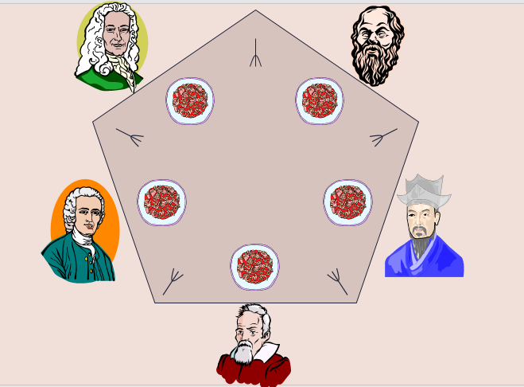
Introduction
Problem Overview
The Dining Philosophers Problem involves multiple philosophers sitting around a dining table, thinking, and eating.
Challenge: Avoid conflicts over shared resources (forks).

Slide 4
Solution Components
01.
Threaded Execution:
02.
Locks and Condition Variables:
Each philosopher is a separate thread.
Locks control access to shared resources.
Condition variables handle synchronization between threads.

Slide 5
Code Explanantion
01.
Section 1 (Code Setup)
02.
Section 2 (Defining Functions)
03.
Section 3 (Ending)

Slide 6
Code Explanation (Section 1)
Importing Libraries
import threading
import time
import random
Philosophers and Neighbours Configuration
state = [0] * NUMPHIL identity = [0, 1, 2, 3, 4]
lock = threading.Lock()
cond = [threading.Condition(lock) for _ in range(NUMPHIL)]
NUMPHIL = 5
num_iterations = 1
LEFT = lambda i: (i - 1 + NUMPHIL) % 5
RIGHT = lambda i: (i + 1) % 5
Philosophers states and synchronization setup:

Slide 7
Code Explanation (Section 2)
Philosophers' Thinking Simulation
def think(id):
think_time = random.randint(1, 3)
print(f"Philosopher {id} is thinking for {think_time} seconds")
time.sleep(think_time)
print(f"Philosopher {id} reappears from sleep from thinking")
Function Definition
Generate Random Thinking Time
Simulate Thinking Time

Slide 8
Code Explanation (Section 2)
Philosopher Fork Pickup and Eating Authorization
def pickup_forks(id):
left = LEFT(id)
right = RIGHT(id)
with lock:
state[id] = 1 # HUNGRY
while state[id] == 1 and (state[left] == 2 or state[right] == 2):
print(f"Philosopher {id} is hungry and waiting to pick up forks to eat")
cond[id].wait()
if state[id] == 1:
state[id] = 2 # EATING
print(f"Philosopher {id} is allowed to eat now")
Lock-Protected Fork Pickup
Waiting Mechanism
Eating Authorization

Slide 9
Code Explanation (Section 2)
Philosopher Eating Simulation
def eat(id):
eating_time = random.randint(1, 3)
print(f"Philosopher {id} is eating for {eating_time} seconds")
time.sleep(eating_time)
print(f"Philosopher {id} reappears from sleep from eating")
Random Eating Time Generation
Eating Duration Display
Sleep Simulation for Eating

Slide 10
Code Explanation (Section 2)
Returning Forks and Signalling Neighbours
def return_forks(id):
left = LEFT(id)
right = RIGHT(id)
with lock: state[id] = 0 # THINKING
print(f"Philosopher {id} has put down forks") cond[left].notify()
print(f"Philosopher {id} signaled philosopher {left} to see if it can eat")
cond[right].notify()
print(f"Philosopher {id} signaled philosopher {right} to see if it can eat")
Transition to Thinking State:
Notification of Fork Availability:
Neighbours Signalling Messages

Slide 11
Code Explanation (Section 3)
Loop Iterations
Iteration Control:
Philosophers go through the cycle for a set number of iterations.
Main Program:
Threads are created, started, and joined to ensure completion.

Slide 12
Challenges and Considerations
Deadlock Avoidance:
The solution ensures no deadlocks occur.
Concurrency Management:
Threads and synchronization mechanisms handle concurrent execution.

Slide 13
Conclusion
Achievements:
Successful concurrent solution to the Dining Philosophers Problem.
Considerations for Real-World Scenarios:
Scalability and performance considerations.

Slide 14
THANKS A LOT!
Do you have any questions?

